Slide 1

Sparse Tensor Core: Algorithm and Hardware Co-Design for
Vector-wise Sparse Neural Networks on Modern GPUs
Lei Yang, Zheyu Yan, Weiwen Jiang, Yiyu Shi University of Notre Dame
Facebook
Georgia Institute of Technology
Micro, 2019

Slide 2
Outline
Background and Challenge
Problem Definition and Framework
Experiments and Thinking

Slide 3
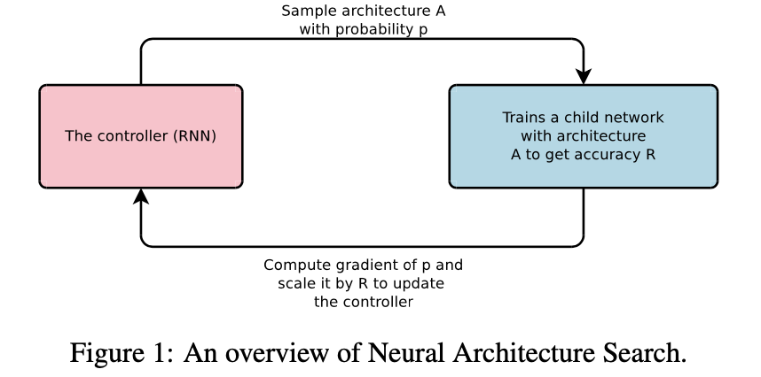
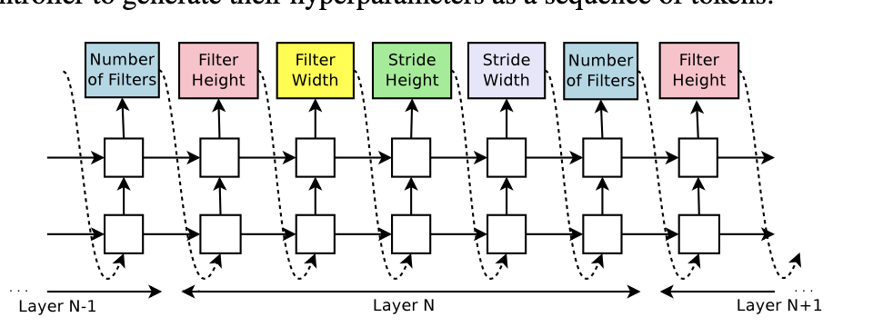
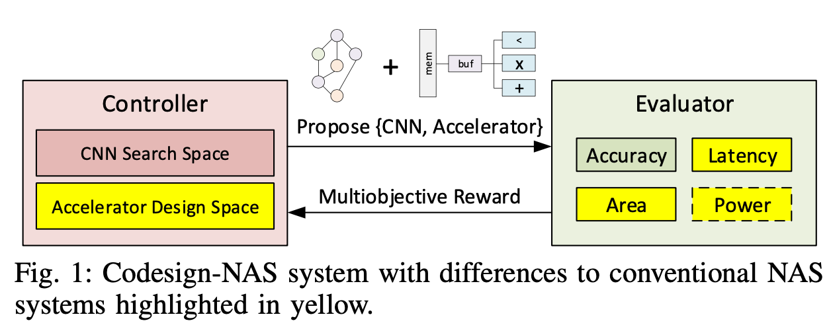
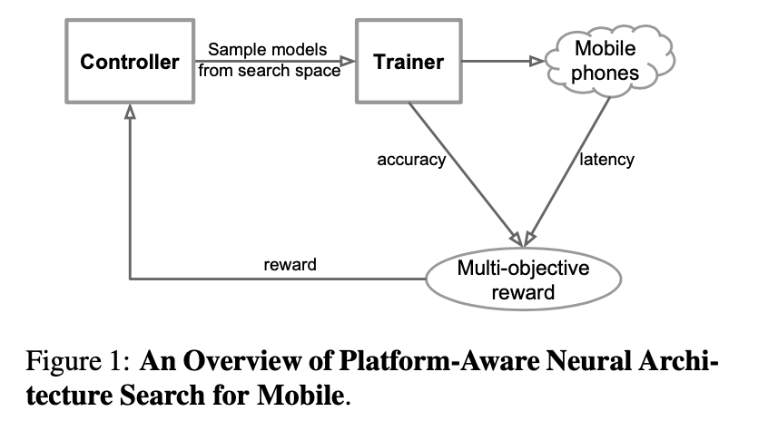
Background
NAS
Hardware-aware NAS
Hardware-Architecture Codesign NAS
Notes:
最常见的NAS，搜索network architecture,或者说 network topology。常见的search space包括：
Hardware-aware NAS，同时兼顾model accracy 以及 hardware performance。比如左下图中的platform为mobile phones，那么就是每个episode采样出一个model，除了训练这个model得到对应的accuracy之外，还要将其部署到对应的硬件平台上，得到real-world inference latency，而不是使用FLOPs等作为代理。Hardware的好处是能真正搜出适合这个硬件平台的architecture，因为FLOPs和真实的latency并不是一一对应单调的关系。
Hardware-Architecture co-design NAS，那么就是在搜索空间既包含network architecture的参数，也包含hardware design，通常是专用加速器的参数。专用集成电路ASIC是最有潜力实现大批量快速的AI 加速的硬件，因此很有必要进行ASIC架构的 codesign NAS。

Slide 4
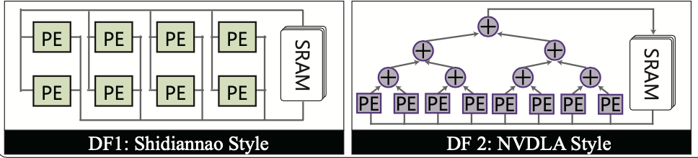
Challenge
1. How to enable the co-exploration of neural architectures and ASIC accelerator designs?
GPUs with fixed hardware, FPGAs with well-structured hardware, ASIC with maximum flexibility → large design space of ASIC
Existing ASIC AI accelerator has a specific dataflow, e.g. Shidiannao, NVDLA, Eyeriss.
Build a set of accelerator templates. Each corresponds to a dataflow style and a fixed hardware structure. On top of it, we only need to allocate resource for templates.
Notes:
Eyeriss ISCA2015； shidiannao ISCA2016；
NVDLA 使用adder-tree来计算partial sum of output feature maps；
冯诺伊曼的一些架构，比如GPU拥有固定的硬件配置，FPGA的各个硬件单元都是结构良好的。
相比较而言，ASIC有最大的设计的自由度，因此如果要将 ASIC design 纳入搜索，它所带来的搜索空间也是最大的。
作者找到的一个方法是：借用现有的著名的ASIC 加速器的数据流。
著名的ASIC 加速器的数据流 --》 加速器模版。选择模版与分配资源。

Slide 5
Challenge
2. Multiple neural architectures need to be identified under the unified design specs.
Realistic applications require the collaboration of multiple tasks. The multiple DNNs have unified design specifications, including latency, energy and area. Need to be simultaneously optimized.
One dataflow is not suitable for all architectures. Integrate multiple heterogeneous sub-accelerators in one ASIC accelerator.
Notes:
在边缘端实际使用的不仅是一个task，而是多个 tasks 可能都需要在同一块 ASIC 加速器上运行。（我觉得这个challenge 并不突出？）
1.多个 DNN 要共享 ASIC 片上资源，
2.没有任何一个 dataflow 在任意任务上都优于其他的dataflow --》 因此作者提出要在ASIC集成多个异构的子加速器。

Slide 6
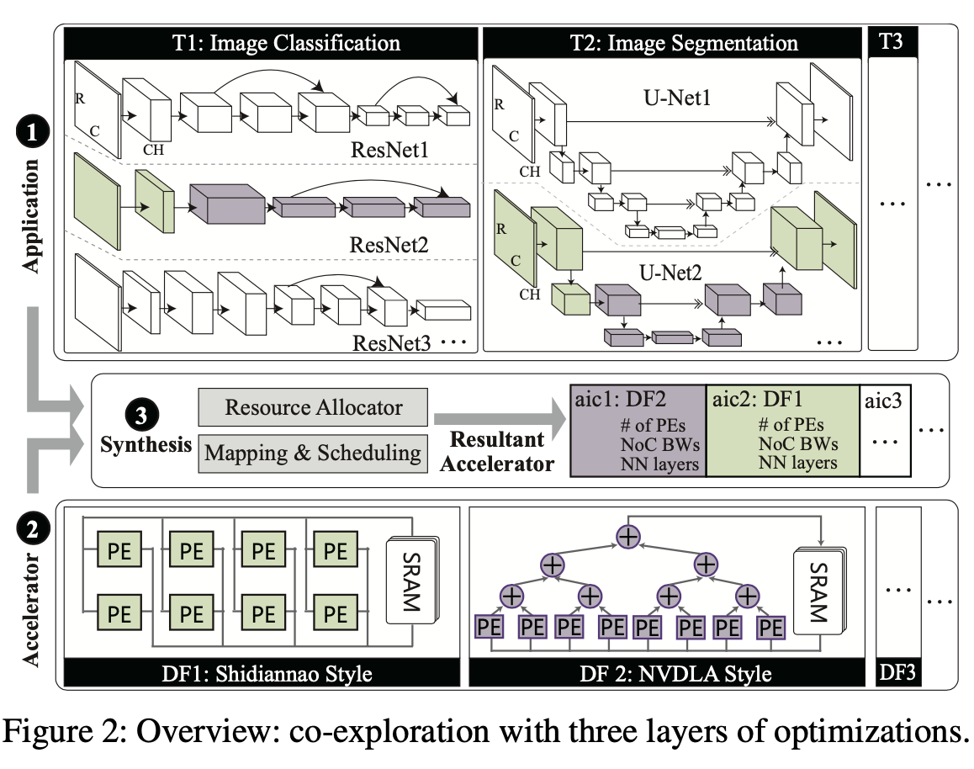
Problem Definition
Application: determines the neural architectures;
Accelerator: creates an ASIC template set;
Synthesis: allocates a template with the resources to each sub-accelerator; map and schedules the network layers to sub-accelerators.
Notes:
为了达到 co-design .作者将搜索划分为3部分
Application: 决定一个neural architecture，这就是最普通的NAS所做的工作
Accelerator：基于给定的已有的加速器设计的 dataflow style，选择一种或者多种 ASIC templates.
Sythesis: 包括两个部分，一个是 resource allcator, 决定加速器的每一个子模块，也就是第二步里所选出的子加速器分配资源。第二部分是将网络的每一层映射到ASIC加速器上，并给出调度顺序。
Sythesis作为桥梁，连接architecture和hardware的搜索。
加下来我会更仔细的介绍这三个模块

Slide 7
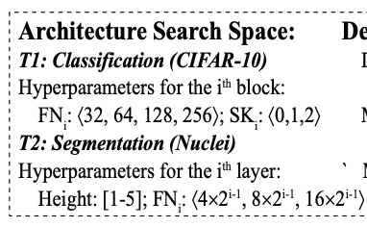
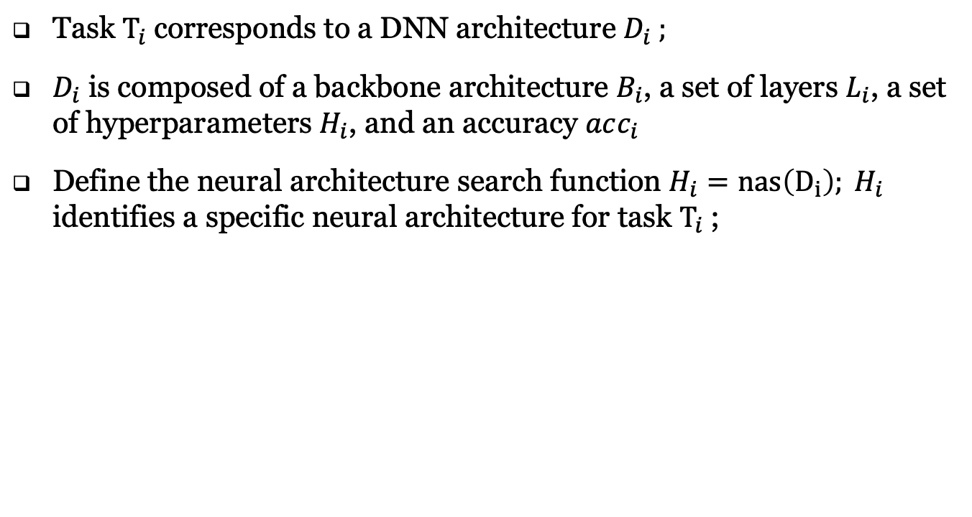
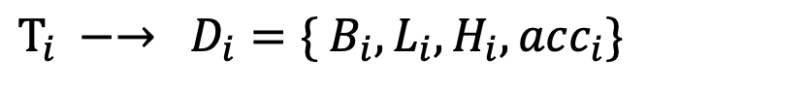
Application
$T_{i} −→ D_{i}=\{ B_{i}, L_{i}, H_{i}, acc_{i}\}$
Task $T_{i}$corresponds to a DNN architecture $D_{i} ;$
$D_{i}$ is composed of a backbone architecture $B_{i}$, a set of layers $L_{i}$, a set of hyperparameters $H_{i}$, and an accuracy $acc_{i}$
Define the neural architecture search function $H_{i}=nas\left(D_{i}\right); H_{i}$ identifies a specific neural architecture for task $T_{i}$;
Notes:
边缘端有多个 task，每一个就是一个 Ti
对于每一个 task，都有一个 DNN architecture;
DNN architecture Di 由4部分定义，Bi 指的是backbone model，layer指的是backbone model的层数，这两个都是作者给定的，比如右下角展示的 CIFAR-10的 classification任务的backbone是 9层的resnet； segmentation 任务使用的是 U-net.
Hi 指的是网络的一系列的超参数，所有architecture search 真正搜索的也就是Hi，比如Resnet9种filter number，以及 skip layer的数量；U-net中的高度height和filter number；
Acc_i 指的是这个DNN architecture对应的accuracy；

Slide 8
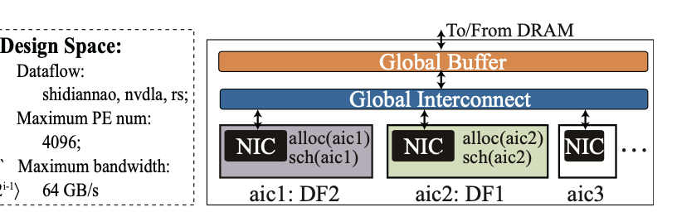
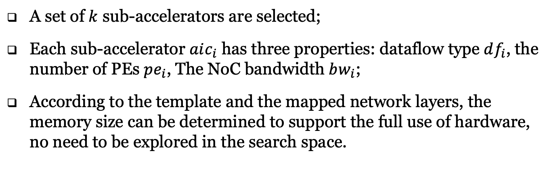
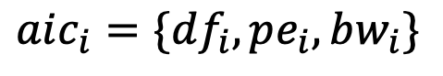
ASIC Accelerator
$$aic_{i}=\{df_{i}, pe_{i}, bw_{i}\}$$
A set of $k$ sub-accelerators are selected;
Each sub-accelerator $aic_{i}$ has three properties: dataflow type $df_{i}$, the number of PEs $pe_{i}$, The NoC bandwidth $bw_{i}$;
According to the template and the mapped network layers, the memory size can be determined to support the full use of hardware, no need to be explored in the search space.
Notes:
多个子加速器 aic_i；
ASIC accelerator 的搜索需要确定 3 个方面：
选择哪几个 sub-accelerator，这个只能从search space 给出的3中 ASIC design中3选1，选定一个 sub-accelerator,确定一个dataflow pattern；
这里应该是拥有的最大带宽和PE数量
给每个 sub-accelerator（分配？？）多个少 PE（processing engines）
给每个 sub-accelerator分配多大的带宽；
注意的是，由于memory size是根据需要能够被全用的，因此不需要放入search space中。

Slide 9
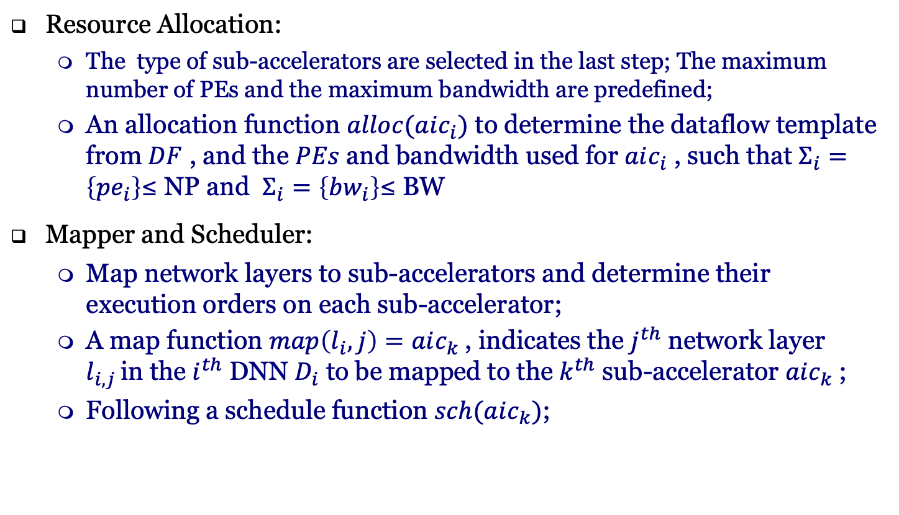
Synthesis
Resource Allocation:
The type of sub-accelerators are selected in the last step; The maximum number of PEs and the maximum bandwidth are predefined;
An allocation function $alloc(aic_{i})$ to determine the dataflow template from $DF$ , and the $PEs$ and bandwidth used for $aic_{i}$ , such that $Σ_{i}=\left\{pe_{i}\right\}$≤ NP and $Σ_{i}=\left\{bw_{i}\right\}$≤ BW
Mapper and Scheduler:
Map network layers to sub-accelerators and determine their execution orders on each sub-accelerator;
A map function $map\left(l_{i}, j\right)=aic_{k}$, indicates the $j^{th}$ network layer $l_{i,j }$in the $i^{th}$ DNN $D_{i}$ to be mapped to the $k^{th}$ sub-accelerator $aic_{k}$;
Following a schedule function $sch(aic_{k})$;
Notes:
Synthesis 分成2部分：
第一部分是确定资源分配：
Sub-accelerator在上一步被选好了的，最大Pes和最大带宽是预先设定的；
Resource Allocation 的目的就是确定每一个sub-accelerator获得上述资源的具体值；
第二部分是确定映射和调度顺序；
映射确定每一个DNN的每一层被映射到哪一个 sub-accelerator上；
调度确定每一个 sub-accelerator上的调度执行顺序；

Slide 10
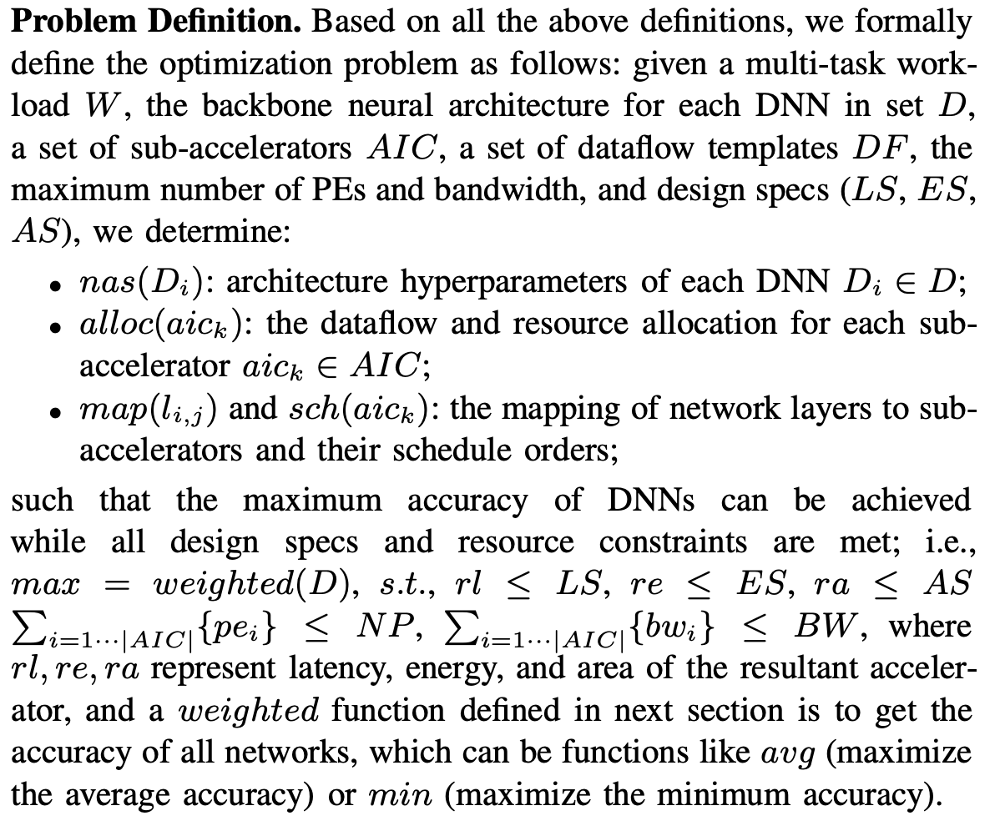
Problem Definition
Notes:
总结：
给定 任务work-load, 每个任务对应的backbone D， 可选择的子加速器类型，最大Pes和带宽，latency，energy和area的限制，
需要做到以下几件事：
确定architecture的具体参数；
确定每个子加速器的dataflow类型和资源分配；
确定映射和调度顺序。
以至于所有的限制（带宽和PE）以及要求（latency，energy和area）都能满足

Slide 11
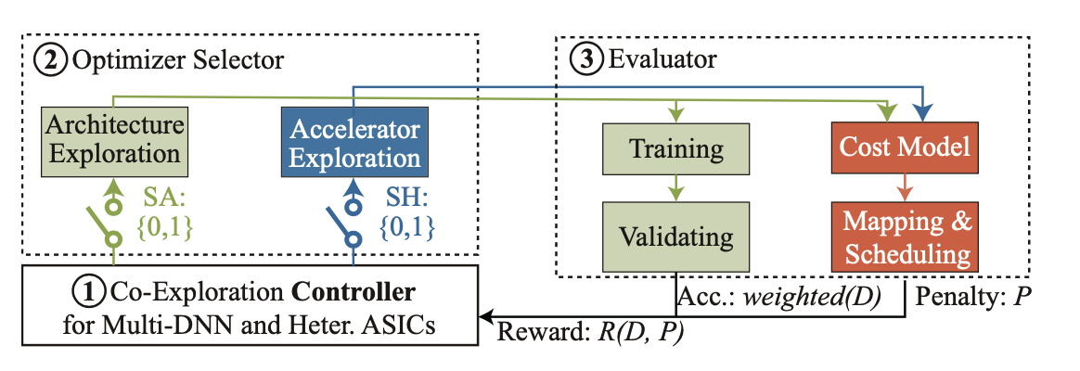
Co-design Framework
The controller first samples neural architectures and hardware resource allocation in each episode ；
Then the predicted sample goes through the optimizer selector and evaluator to generate the accuracy and hardware cost.
Finally, a reward is generated to update the controller.

Slide 12
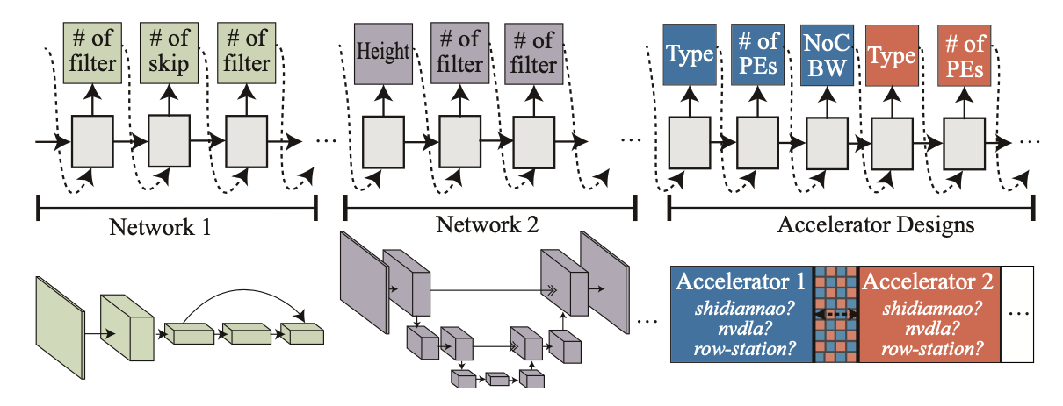
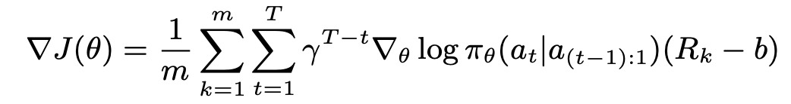
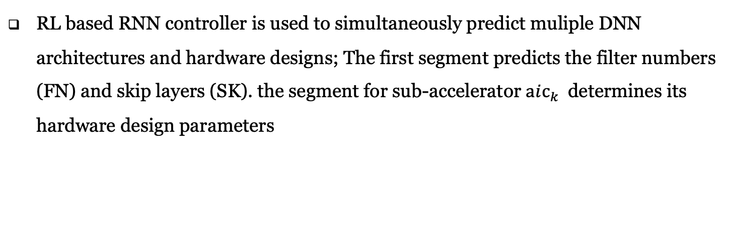
Controller
RL based RNN controller is used to simultaneously predict muliple DNN architectures and hardware designs; The first segment predicts the filter numbers (FN) and skip layers (SK). the segment for sub-accelerator $aic_{k}$determines its hardware design parameters
Monte Carlo policy gradient to update the controller:
Notes:
RNN controller。两部分，一部分预测DNN architecture的hyperparameters，另一部分预测子加速器的hyperparameter
Controller的更新，使用的基于蒙特卡洛的策略梯度下降的方法。M是 batch size；T是1个episode里的steps数量。Reward会被discount。b是average exponential moving of rewards。

Slide 13
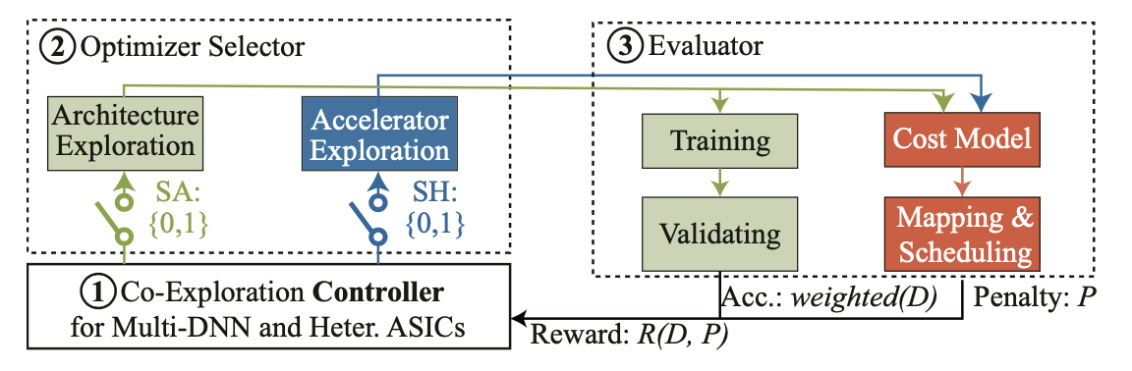
Optimizer Selector
Step 1: SA=1, SH=1, aims to obtain new neural architecture and hardware design;
Step 2: SA=0, SH=1, to explore the best hardware for a previous identified neural architecture
Notes:
图中可以看到，有两个门SA和SH，分别控制 architecture exploration 和 accelerator exploration；
第一阶段，SA和SH两个门均合上，同时探索neural architecture 和 hardware design；
第二阶段，对于搜到的一个architecture，在此基础上继续搜索最优的 hardware design；

Slide 14
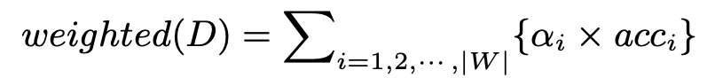
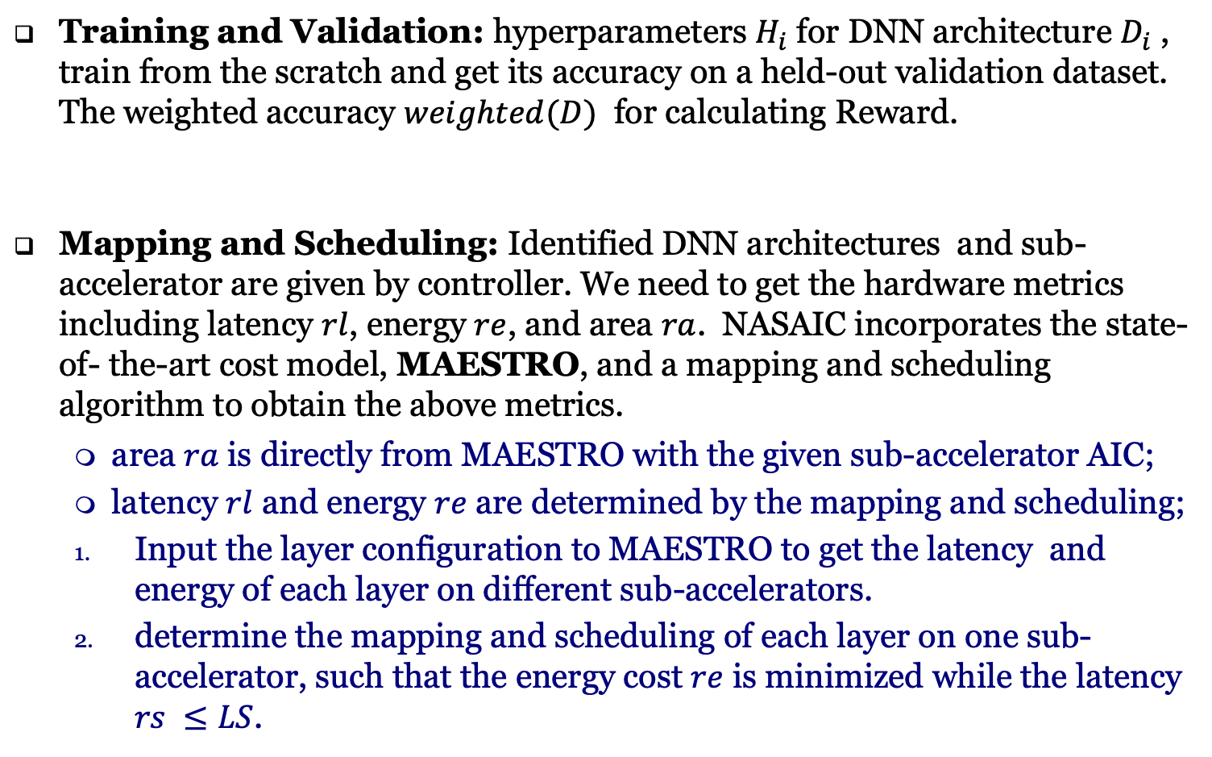
Evaluator
Training and Validation: hyperparameters $H_{i}$ for DNN architecture $D_{i}$ , train from the scratch and get its accuracy on a held-out validation dataset. The weighted accuracy $weighted(D)$ for calculating Reward.
Mapping and Scheduling: Identified DNN architectures and sub-accelerator are given by controller. We need to get the hardware metrics including latency $rl$, energy $re$, and area $ra$. NASAIC incorporates the state-of- the-art cost model, MAESTRO, and a mapping and scheduling algorithm to obtain the above metrics.
area $ra$ is directly from MAESTRO with the given sub-accelerator AIC;
latency $rl$ and energy $re$ are determined by the mapping and scheduling;
Input the layer configuration to MAESTRO to get the latency and energy of each layer on different sub-accelerators.
determine the mapping and scheduling of each layer on one sub- accelerator, such that the energy cost $re$ is minimized while the latency $rs ≤LS$.

Slide 15
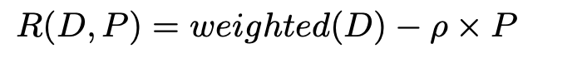
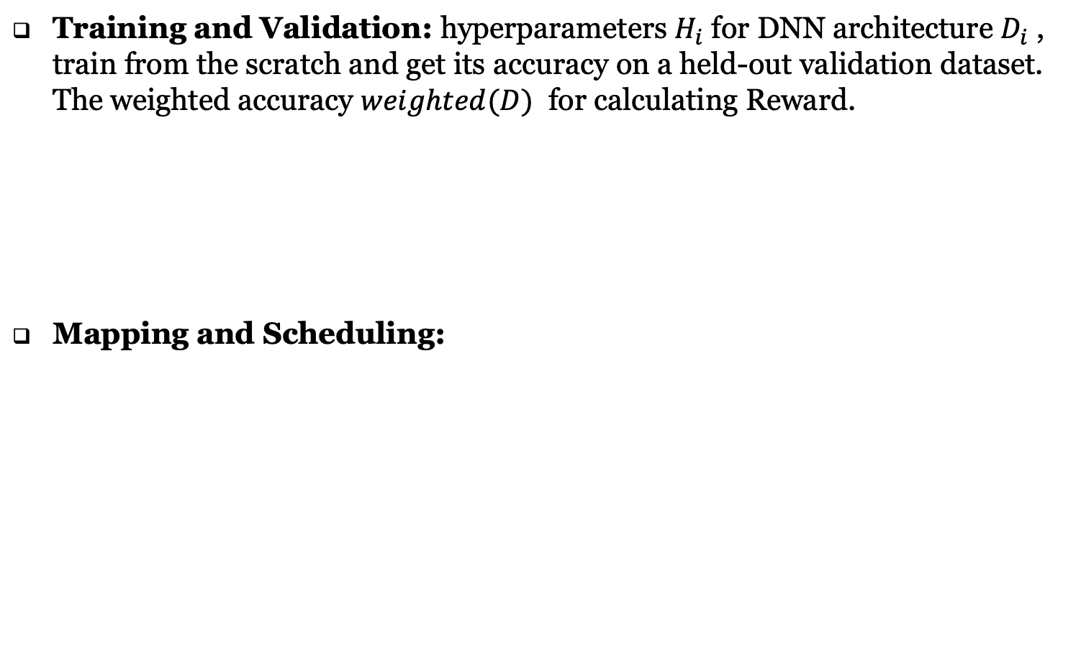
Evaluator
Training and Validation: hyperparameters $H_{i}$ for DNN architecture $D_{i}$ , train from the scratch and get its accuracy on a held-out validation dataset. The weighted accuracy $weighted(D)$ for calculating Reward.
Mapping and Scheduling:
Notes:
Training and evaluation 的目的是返回一个 acc
Weighted(D)是acc对应的reward项，P是hardware design对应的penalty，下一页会介绍具体值

Slide 16
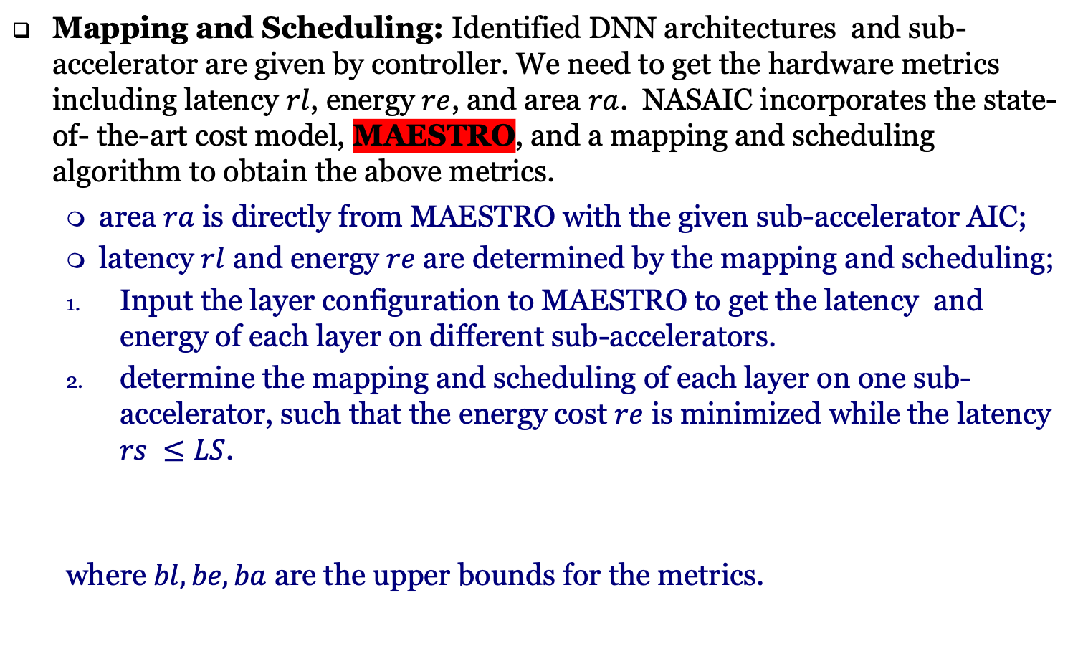
Evaluator
Mapping and Scheduling: Identified DNN architectures and sub-accelerator are given by controller. We need to get the hardware metrics including latency $rl$, energy $re$, and area $ra$. NASAIC incorporates the state-of- the-art cost model, MAESTRO, and a mapping and scheduling algorithm to obtain the above metrics.
area $ra$ is directly from MAESTRO with the given sub-accelerator AIC;
latency $rl$ and energy $re$ are determined by the mapping and scheduling;
Input the layer configuration to MAESTRO to get the latency and energy of each layer on different sub-accelerators.
determine the mapping and scheduling of each layer on one sub- accelerator, such that the energy cost $re$ is minimized while the latency $rs ≤LS$.
where $bl, be, ba$ are the upper bounds for the metrics.
Notes:
MAESTRO是作者选的一个 cost model。
基于这个 cost model，能够直接给出搜索出各个子加速器部署所需要的 area；
然后这个cost model，也可以直接计算出每个网络每一层在每一个子加速器上的 latency和 energy；
先满足latency等目标，然后看他的energy能否满足要求，这就能确定能不能找到符合各种 design specification的hardware design；
同时，这个P计算的是硬件设计这一部分的penalty

Slide 17
Workloads and Datasets
Workloads:
W1: Tasks on one classification dataset (CIFAR-10) and one segmentation dataset (Nuclei).
W2: Tasks on two classification datasets (CIFAR-10, STL-10).
W3: Tasks on the same classification dataset (CIFAR-10).
Notes:
3种 workloads，每个两个tasks；
#Classification任务和segmentation任务的backbone

Slide 18
Search Spaces and limitations
Backbone and Search space of Architecture:
Classification -- Resnet9 -- The number of convolution layer and the number of filter channels for each residual block;
Segmentation – U-Net -- The number of height and filter channel number in each layer;
Hardware Configuration:
The maximum number of PEs to be 4096 and the maximum NoC bandwidth to be 64GB/s;
Each sub-accelerator uses one of the following dataflows: Shidiannao, NVDLA, and row-stationary style.
Design specifications, including Latency (cycles), Energy (nJ), Area (μm2), for each application workload as follows: ⟨8e5, 2e9, 4e9⟩ for W 1; ⟨1e6, 3.5e9, 4e9⟩ for W2; ⟨4e5,1e9,4e9⟩ for W3.
Notes:
Classification任务和segmentation任务的backbone,以及在给定backbone下architecture的搜索空间
最大PE数4096，带宽 64GB/s
3种可选的子加速器
不同workload下，关于 latency，ennrgy，area都有不同的design specifications

Slide 19
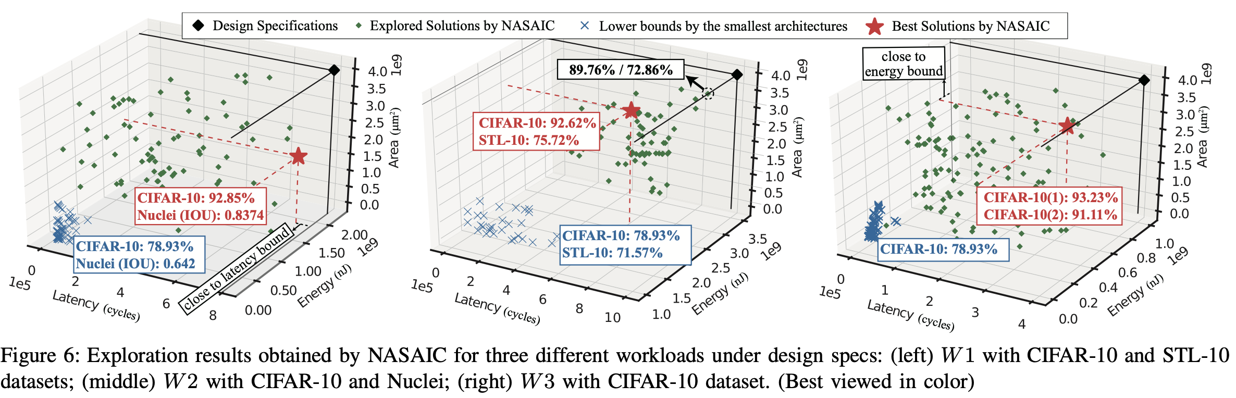
Experiments -- Design Space Exploration
All the explored solutions meet the design specifications;
The identified solutions have high accuracy ;
Best solutions of W1 and W3 are quite close to the boundary defined by one of the three design specs → in these cases the accuracy is bounded by resources.
Best solution of W2 is farther away from the specs, the best solution may not always be the one closest to the specs.
Notes:
蓝色： lower bounds；最小网络的下限；
绿色： 搜索过程中一些符合 design specification的点
红色： 最优搜索结果
1. 搜索结果总是满足 design specification的
2. The accuracy on CIFAR-10 of the four solutions are 92.85%, 92.62%, 93.23%, and 91.11%, while the accuracy lower bounds from the smallest network is 78.93%
3. 1，3的结果至少有一个维度接近资源限制；2的结果并不如此，说明最好的solution可能并不靠近specs。值得注意的是，2的acc比1，3低。
[并不是越接近资源越好，主要还是因为reward function加入了penalty]

Slide 20
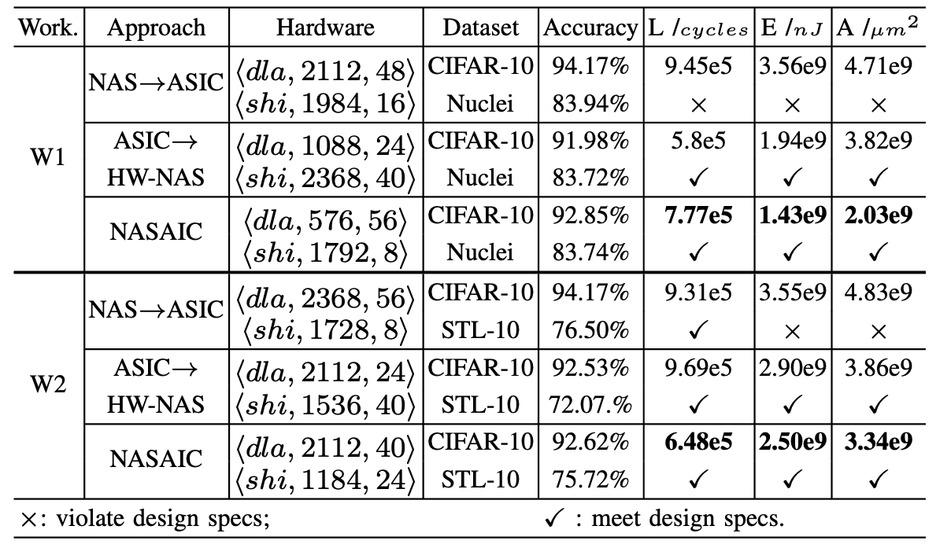
Experiments – Results on Multiple Tasks
None of the accelerator designs explored by the brute-force approach can provide a legal solution that satisfies all design specs.
Solutions by NASAIC meet all specs with the average accuracy loss of 0.76% and 1.17%, respectively; W1, NASAIC achieves 17.77%, 2.49×, and 2.32× reductions on latency, energy, and area (30.39%, 29.58%, and 30.85%. For W2);
ASIC→HW-NAS is closer to the design specs, for W1, NASAIC achieves 0.87% higher accuracy for CIFAR-10 and similar accuracy for Nuclei;
Notes:
All the above results have revealed the necessity and underscored the importance of co-exploring neural architectures and ASIC de- signs. 1. 传统NAS的结果都不满足 design specs；
2.NASAIC的所有结果都满足 design specs， accuracy loss低，latency， energy 按到 area都有变好；
3.比起hardware-aware NAS，准确率更高，硬件效率更高，说明有必要co-exploring；

Slide 21
Thinking
第一篇结合 ASIC design search 和architecture search的文章；
3.5 GPU hours with 500 episodes，不可信

